Slide 1
CloudFarmer
L. van de Beek K.K.J. Burgers M. Ghanem A.N. Groote Woortmann M.J.B. Keizer
B. van Leeuwen L.A. Roozen W.J.A. van Santvoort H.P.A. Swinkels

Slide 2


The Project
Who are we What do we do

Slide 3

Front-end
React

Slide 4
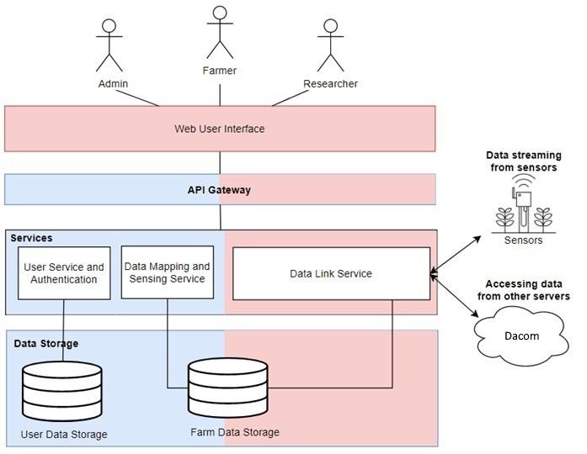
Back-end
Four main components:
User & Authentication service
Data Sensing service
Data Mapping service
Data Linking service

Slide 5
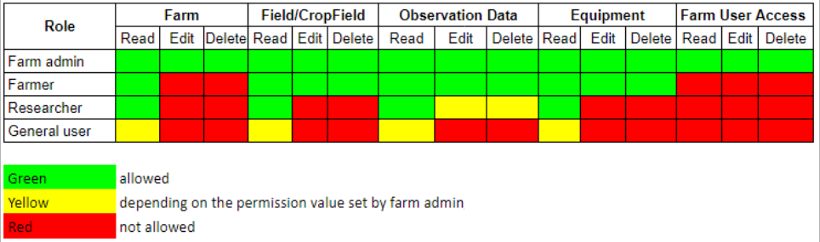
User & Authentication service
JWT tokens are sent with each request
Four user permission types:
Farm admin
Farmer
Researcher
General user

Slide 6
Data sensing service
Manual input of observation data
Farm control:
Fields
Crop fields
Crop types
Equipment

Slide 7
Data mapping service
Metadata
Equipment model
Handled by the client

Slide 8
Data Linking service
Return data from providers (APIs)
Convert data to standard format
Provide saving of observation data to database from API
CRUD data by user

Slide 9

Thank you for your attention

